Slide 1
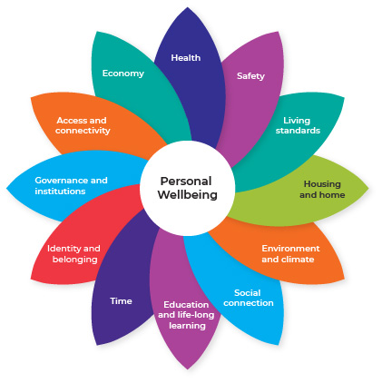
Women’s Health Matters
An independent, non-partisan think tank that works to improve the health and wellbeing of women in the ACT and surrounding regions.
Our Purpose:
We are the voice for women’s health and wellbeing in the ACT.
We align our work with and seek to influence the ACT Government’s Wellbeing Framework.
Our priority domains are Health and Safety. We also work in other domains where they contribute to and impact on the health and safety of women in the ACT.
Our local research, evidence and data (informed by women for women) is used by decision makers to be more responsive to the needs of women and to improve the health and wellbeing of women in the ACT.
Our guidance supports ACT women to make informed health and wellbeing choices and to understand how to access appropriate gender-sensitive services and information in the ACT.
Our Goals:
Influencing What Matters!
Communicating What Matters!
Empowering Women in What Matters!
Key Focus Areas:
Knowing What Matters!
Enabling Us To Do What Matters!
Our Values:
Women Focused | Integrity | Social Justice

